Slide 1
Stock Analysis
Fundamental Analysis : Data from Sources
Metrics: Financial statement – balance sheet, income statement, cash flow statement, foot notes
Technical Analysis :
Past and present price action
Analyse the financial market as a
whole
- price & volume, demand & supply
E.g. Using a chart
Fundamental Analysis
Technical Analysis

Slide 2
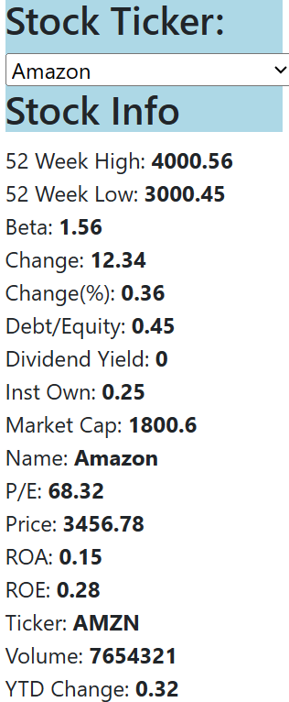
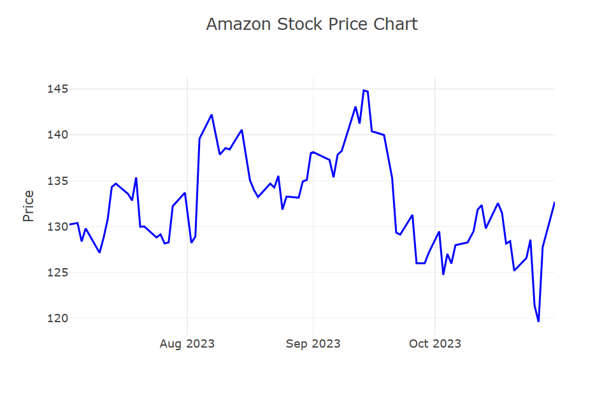
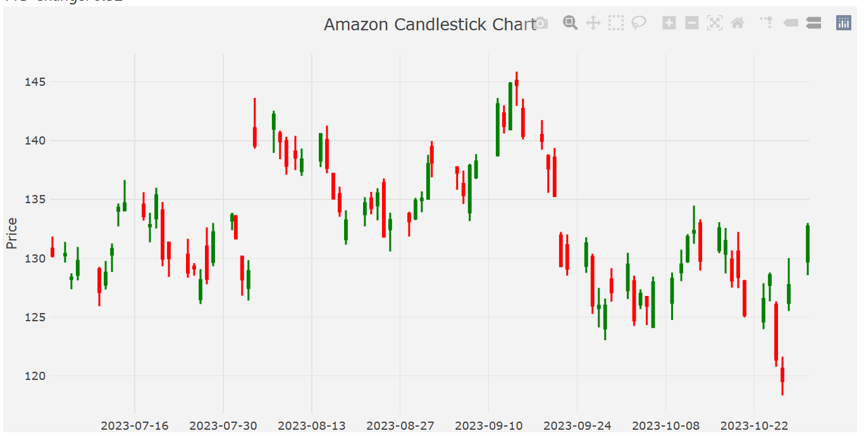
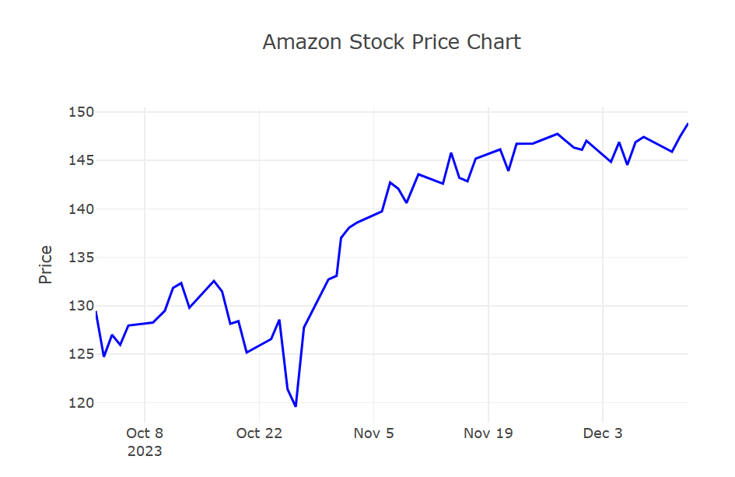
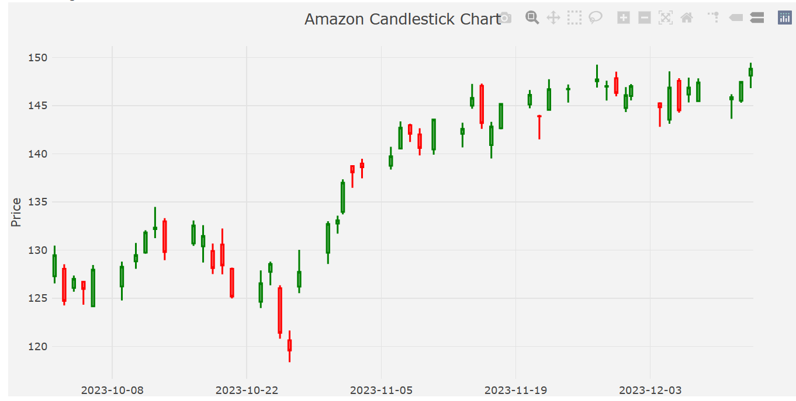
Amazon – Trend Analysis

Slide 3
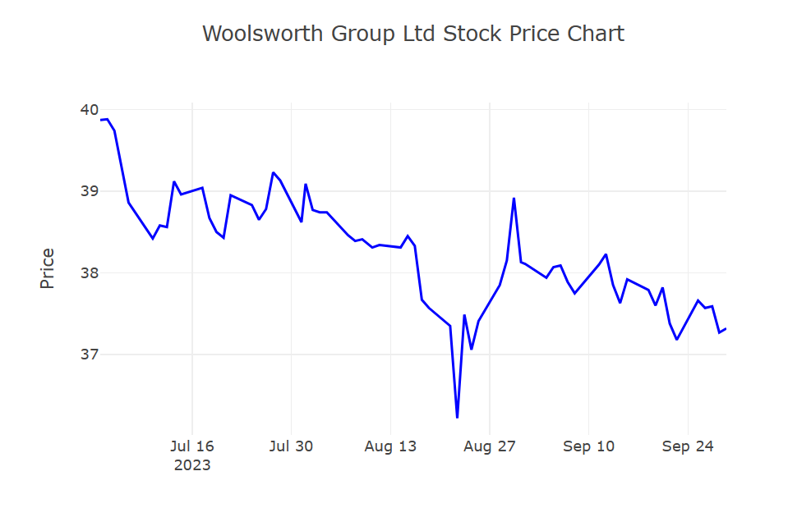
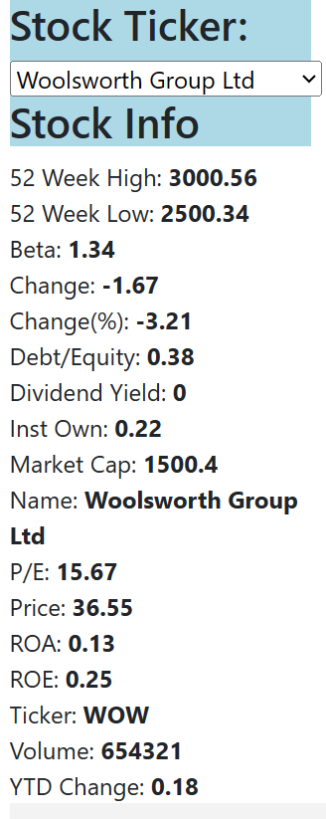
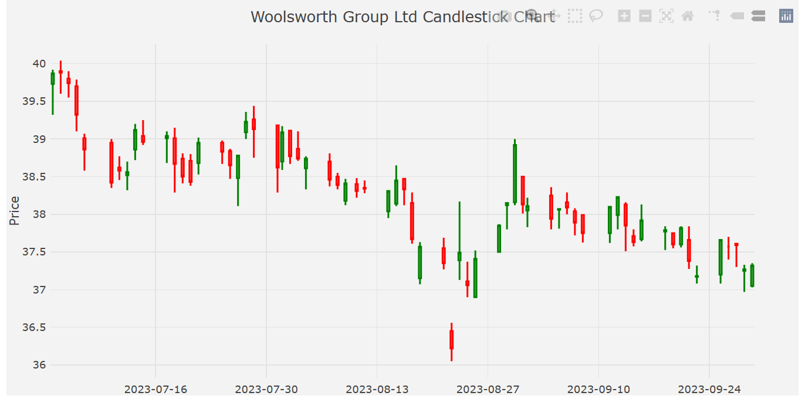
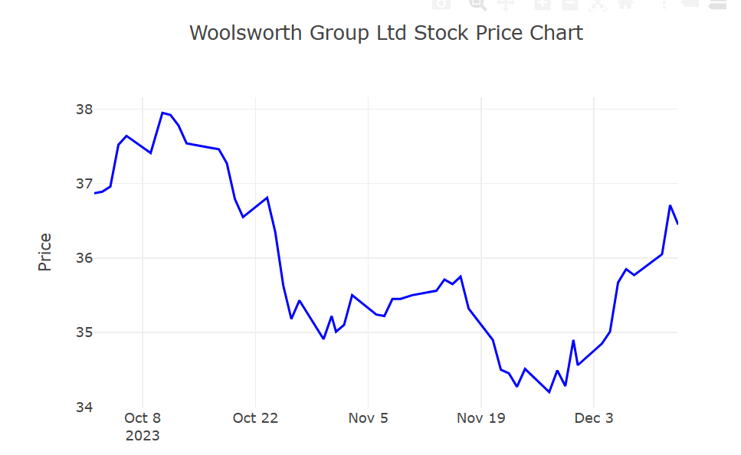
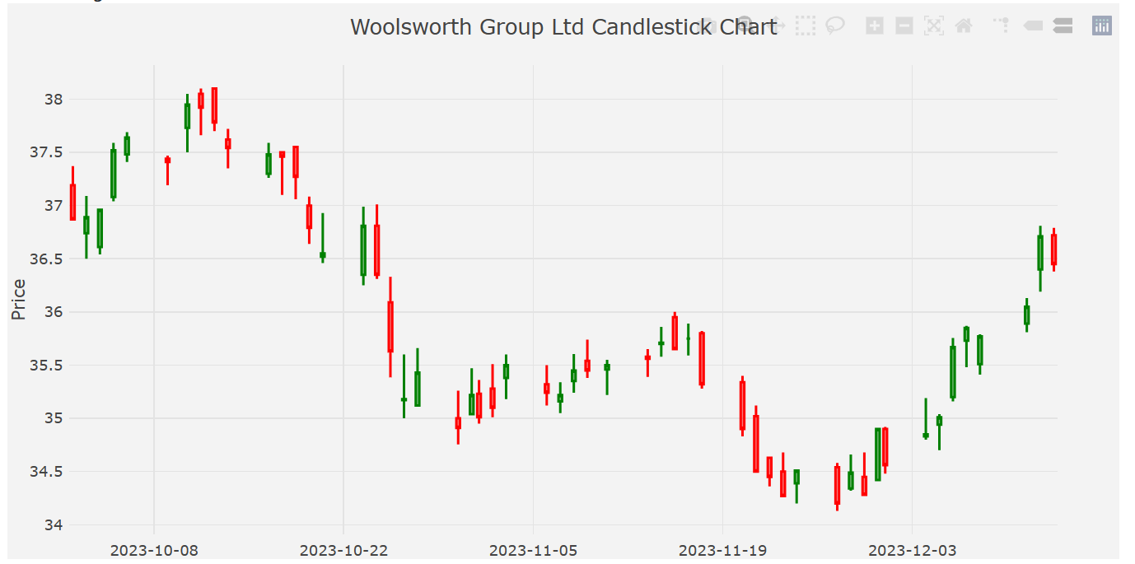
Woolworths – Trend Analysis

